Slide 1
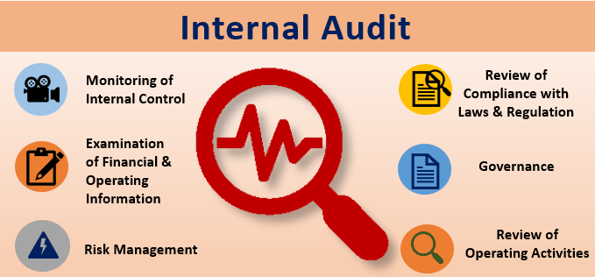
Theory on Internal Auditing

Slide 2
Introduction
Integral part of modern business
Most challenging, dynamic and exciting professional career
Demand for the profession – seeking quality assistance
Right hand of management providing assurance that policies, plans and procedures are adhered to
Fulfil consulting roles, investigating and reporting in critical issues
Frequent contact with top management

Slide 3
History on Internal Auditing
Financial transactions: tick marks, dots, check marks
China and other developing countries adopted the same system
First verification system
Early 1900’s the concept of internal auditing came about : to review and report the effectiveness of the companies organization and governance, risk management and control processes within the organization

Slide 4
The Development of internal Auditors in SA
Role of Internal auditors
As advisors to management, Internal Auditors act as the right hand of the Board of Directors through the Audit Committee by giving assurance on the organisations ability to meet its objectives, its governance, risks and controls.

Slide 5
The Development of internal Auditors in SA
Internal Audit 3.0
The future is now
As organizations hurtle to an increasingly technology-driven, innovation-oriented, risky, and disruptive future, where is internal audit? Very often, despite ongoing efforts to meet stakeholders’ growing list of needs, the answer is playing catch-up.

Slide 6
The Development of internal Auditors in SA
decade of uncertainty, organisations face evolving strategic, reputational, operational, financial, regulatory, and cyber risks. The world is entering the fourth industrial revolution where new technologies, digitalisation, robotics, and artificial intelligence are dramatically changing the business landscape.

Slide 7
Factors that contributed to the development of internal Auditing
Originally, the Role of internal is to test reliability of information that was incorporated in the financial statement
Contributing factors
Effect of increasing transactions
Complexity of transaction
Need for management to have eyes and ears on the field
Role conversion : from “watchdog to a guide dog”(performing assurance activities to assisting and advising management with their activities)

Slide 8
Institute for Internal Auditors IIA (SA)
Founded to look after the needs and expectation of its members and guide them in a continuously changing environment in which they practice their profession
Membership and qualification
Refer to website

